Slide 1
Semester Final – Emmis Communications, Digonex. Fatih Atlamaz

Slide 2
Internship Plans & What I Wanted to Learn
Going into this internship, I had basic knowledge of Python, Java, JavaScript, HTML, and CSS programming, but nothing in a specific field such as Artificial Intelligence or Data Managing. For this reason, all I wanted to learn going into this internship was any specific field or part of computer science.
Furthermore, besides actual content such as programming and algorithms, I wanted to experience a professional setting. I’ve always been good at completing my school-work, but I never really had a job experience before this internship. I wanted to understand and see how it would be like, and while an internship may not be the same thing as a job, I think it’s closer than anything else.

Slide 3
What Went Well & What I Learned
Just like I wanted, I got the opportunity to focus on a specific branch or subject of computer science: web scraping. Before this internship, I had no knowledge regarding web scraping; I didn’t even know what it was! The first month of this internship, I learned about dozens of Python modules that focus on web scraping, but then we ultimately switched to an application called Dexi.io, which offered much better features.
Again, my wishes were fulfilled as I was given the opportunity to enhance my communication skills, which are noted to be very important in a work setting. A one-on-one meeting almost every single day we met, and constant emailing developed my communication skills as well as my flexibility.
Lastly, something I was not expecting from this internship was professional documentation. I never knew the importance of documentation until this internship, and I’m glad that I had the opportunity to document my work. I truly believe the clarity in my words and instructions has enhanced from all the documentation I wrote.

Slide 4
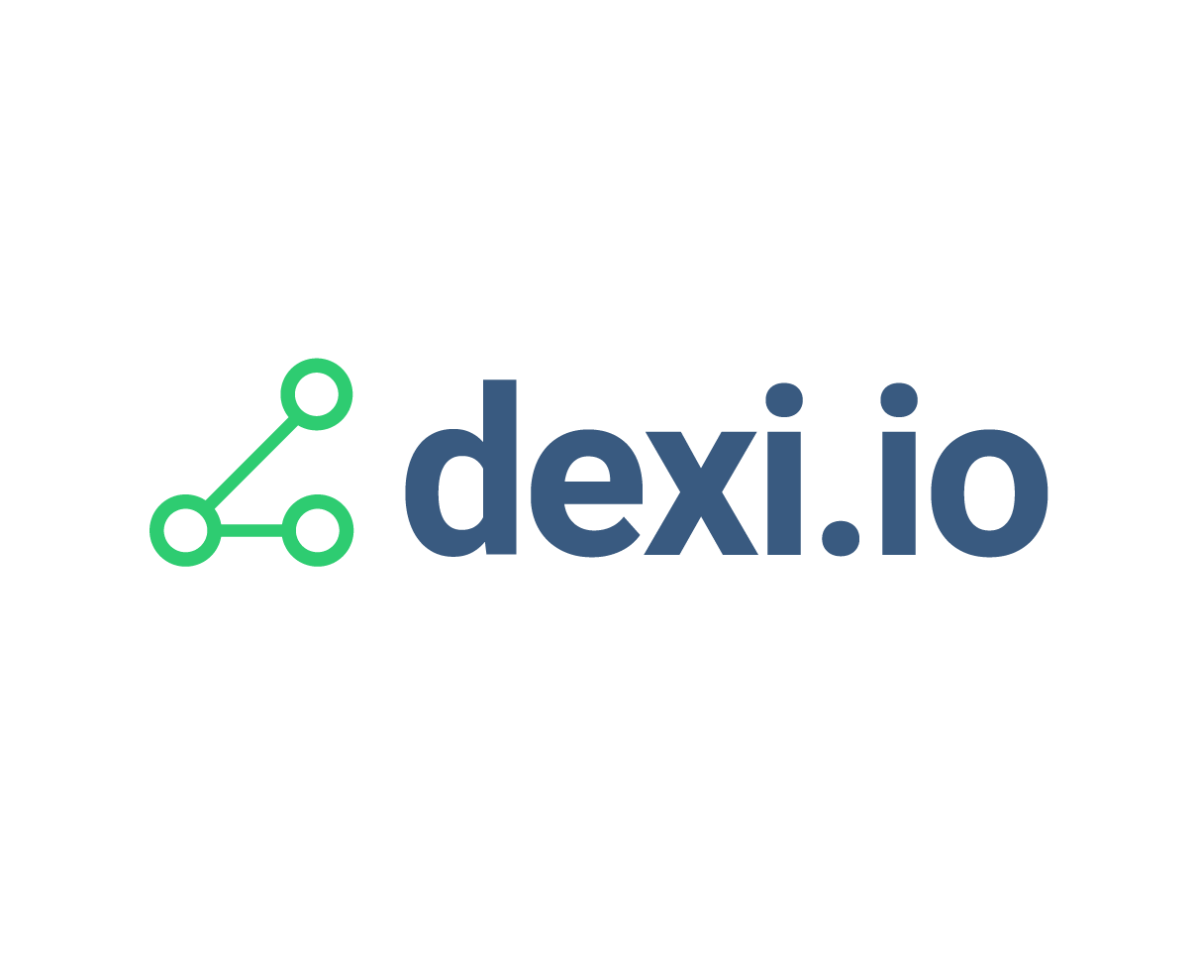
What I Did…
During my internship, I focused on one large project that would save the client services team at Digonex a couple hours every day. I wrote nearly thirty programs that scraped the adult ticket prices off each client’s website and compared them with the price that Digonex set in order to make sure that the client’s website updated, as necessary. Although I can’t show my code or program or even the program in action due to confidentiality, I can share the clients that I focused on. Most clients use different ticketing systems and calendars to display their prices, so nearly every single program was written in different ways.
After writing all the programs, I spent the rest of the year documenting each program. I would explain how to recreate each step as well as the functionality of that step. Besides these client specific documentations, I also documented a “How to use Dexi.io” guide/instructions. Lastly, I created a video of me walking through the making of a client’s program/robot, so that when I am no longer interning there, someone else can use the same method for future clients.
Throughout this entire project, I met with my internship sponsor, Chris Pohl, nearly every single day that I had my internship. I’d share with him my update and progress, and he would share any new information that I’d need to know. I also met with a member of the development team multiple times to talk about my progress and receive some help regarding issues I had with the programs.

Slide 5
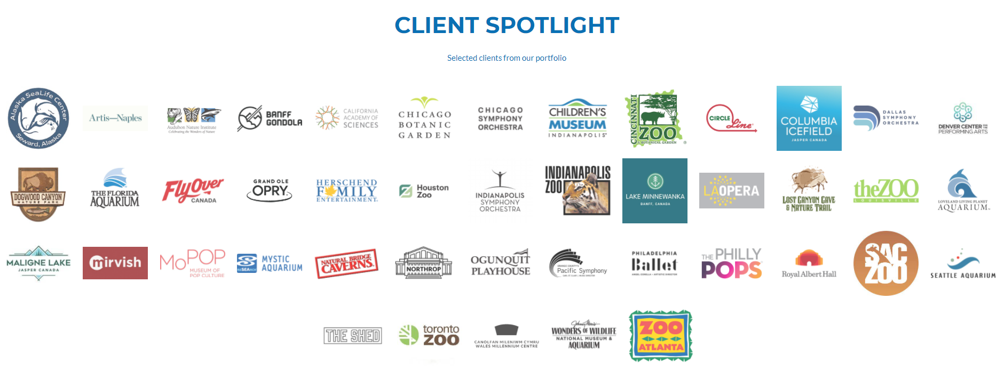
Digonex Clients
These are some of the clients’ websites that I focused my programs on.
Notes:
Current process uses the review results CSV files to check against client we pages – you can see how with the large numbers of attraction clients this can become a time eating process

Slide 6












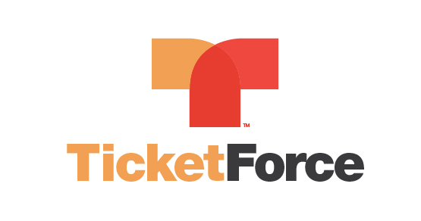



Ticketing System Experience

Slide 7
Problems and Learning Curve
As I mentioned before, I had no previous knowledge on web scraping and my entire internship project was focused on it. What made it more challenging is that the application I used for web scraping was Dexi.io, and the Internet had nearly no guides or instructions for using it. For that reason, I taught myself web scraping with a lot of trial and error as well as exploration of the application’s different features. Now, I’d consider myself to be very experienced and knowledgeable in web scraping using this application. Also, given more time, I think I can use this knowledge to learn web scraping using Python and other programming languages.
Some other problems I’ve had are just program based, where two or three of the thirty to forty programs I’ve created don’t work properly. I cannot find a solution to this problem, so for now, we have just skipped those. Another major issue is that the programs I’ve written quickly get outdated due to the fact that the clients’ websites are constantly changing. Because of this, some of the programs need to be updated nearly one or twice a month. There is no way to get around this issue unfortunately.

Slide 8
Communication and Working with Others
A very big part of my internship was working with my internship sponsor, Chris Pohl. As I’ve mentioned in earlier sections, I met with Chris nearly every single day through Zoom. During these one-on-one meetings, I would give him an update on my progress as well as ask him any questions. Furthermore, I’d share with him the problems that I’m facing, and he would do his best to help. Chris would give me any new information that I’d need to know, and just update me on our project plans.
One time, I joined a company meeting, which was again through Zoom. The CEO, CFO, the Vice President’s and nearly every member of the Digonex branch was present.
In addition, I met with the Vice President of Product Development several times. He was the one who reviewed my documentation and gave me very good feedback.
With all this communication, I believe my interpersonal skills in one-on-one meetings has improved, as well as my flexibility and clarity when communicating problems and information. Also, I think I have improved when it comes to accepting constructive criticism and feedback.

Slide 9
What I’m Most Proud Of
One of the things I’m most proud of about my internship is the fact that I was given a computer science idea: web scraping, which was very new to me, and I managed to teach it to myself in only a couple weeks. Then with my new skill, I was able to create thirty or forty working programs and document nearly half of them in the given time. I didn’t think I would be able to program the necessary algorithms, but I’m thrilled that it was completed.
However, I’m most proud about the fact that I was invited to come back and intern there again next semester. I thought this internship would only last one semester, but I’m very happy that my internship sponsor and Digonex is thrilled with my work.

Slide 10
The Work Place
Although Emmis Communications has an amazing building, I worked remotely due to COVID-19 as well as transportation. The Emmis building is in Indianapolis and a 45-minute drive from here, so I saved an hour and a half by just working from school. I did go to the office a couple of times, but I mostly worked in a CCA room.

Slide 11

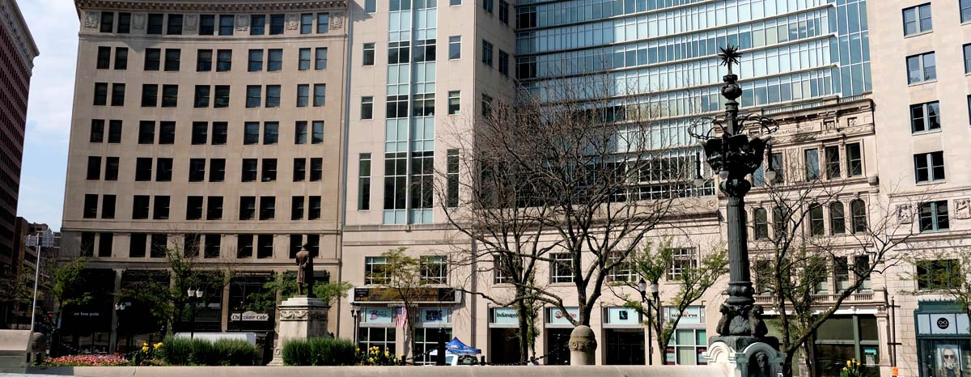
Emmis Building
Located in Indianapolis, Indiana.

Slide 12
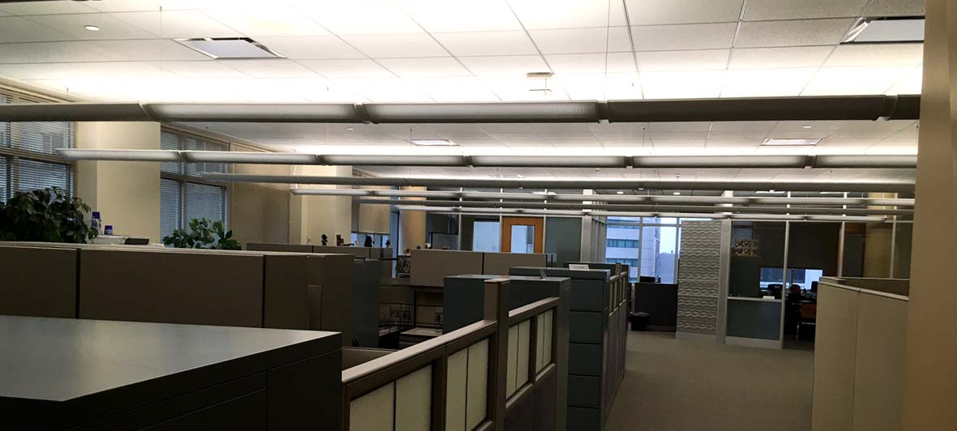
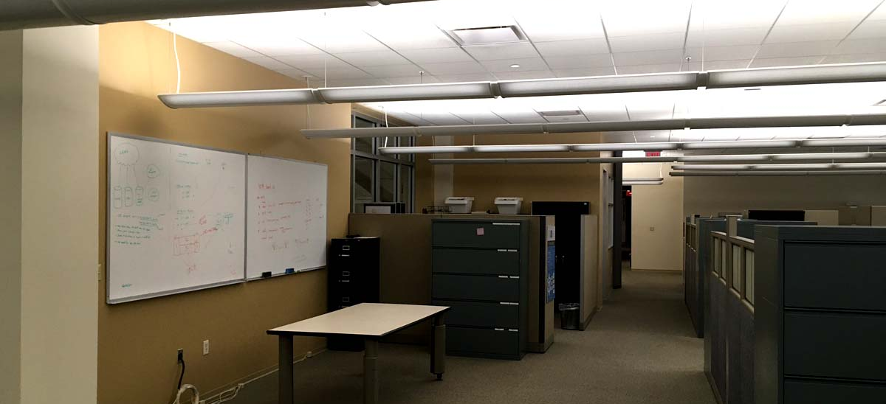
Digonex Floor

Slide 13


Impact on the Future…
This internship has solidified my love for computer science, and I continue to hope to pursue a computer science and mathematics major in college. I’m very glad that I had this opportunity and experience and could not hoped for anything better.

